Slide 1
Module 5 Part 1
Introduction
The 4P’s
W5HH Principle
Project Management
PLC and SDLC

Slide 2
Introduction
Although IT is becoming more reliable, faster, and less expensive, the costs, complexities, and risks of IT projects continue to increase.
According to the survey, user involvement, executive management support, and a clear statement of requirements ranked at the top of the list of factors essential for IT project success. On the other hand, lack of user involvement and incomplete requirements appear to be the two main factors for projects being challenged or canceled before completion.

Slide 3
Definitions
A project is a temporary endeavor undertaken to accomplish a unique purpose.
Project management is the application of knowledge, skills, tools, and techniques to project activities in order to meet or exceed stakeholder needs and expectations from a project.

Slide 4
Attributes of a Project
Time Frame
Purpose
Ownership
Resources
Roles
Risks and Assumptions
Interdependent Tasks
Organizational Change,
Operating in an environment larger than the project itself.

Slide 5
The 4 P’s
People
the most important element of a successful project
Product
the software to be built
Process
the set of framework activities and software engineering tasks to get the job done
Project
all work required to make the product a reality

Slide 6
Stakeholders
Senior managers who define the business issues that often have significant influence on the project.
Project (technical) managers who must plan, motivate, organize, and control the practitioners who do software work.
Practitioners who deliver the technical skills that are necessary to engineer a product or application.
Customers who specify the requirements for the software to be engineered and other stakeholders who have a peripheral interest in the outcome.
End-users who interact with the software once it is released for production use.

Slide 7
To Get to the Essence of a Project (W5HH Principle)
Why is the system being developed?
What will be done? (task set is defined)
When will it be done?(project schedule & milestones)
Who is responsible?(Role of each member)
Where are they organizationally located?(other roles)
How will the job be done technically and managerially?
How much of each resource (e.g., people, software, tools, database) will be needed?(developing estimates)
Barry Boehm

Slide 8
Project Management
Project management is one of those things that looks easy until you try it.
The fundamentals of managing a project from start to finish require a team of individuals with different talents and skills.
Those people are responsible for planning and executing the project objectives and that takes more than just labour and materials.
Each project follows a Project Life Cycle.
A sound project plan can mean the difference between success or failure.

Slide 9
Need for Project Management
Defines a plan and organizes chaos
projects are naturally chaotic.
The primary business function of project management is organizing and planning projects to tame this chaos.
A clear path mapped out from start to finish ensures the outcome meets the goals of your project.
Establishes a schedule and plan
Without a schedule, a project has a higher probability of delays and cost overruns. A sound schedule is key to a successful project.
Enforces and encourages teamwork
A project brings people together to share ideas and provide inspiration.
Collaboration is the cornerstone to effective project planning and management.
Maximizes resources
Resources, whether financial or human, are expensive.
By enforcing project management disciplines such as project tracking and risk management, all resources are used efficiently and economically.

Slide 10
Need for Project Management (contd.)
Manages Integration
Projects don’t happen in a vacuum.
They need to be integrated with business processes, systems and organizations.
You can’t build a sales system that doesn’t integrate with your sales process and sales organization. It wouldn’t add much value.
Integration is often key to project value.
Project management identifies and manages integration.
Controls cost
some projects can cost a significant amount of money so on budget performance is essential.
Using project management strategies greatly reduces the risk of budget overruns.
Manages change
projects always happen in an environment in which nothing is constant except change.
Managing change is a complex and daunting task. It is not optional.
Project management manages change.

Slide 11
Need for Project Management (contd.)
Managing quality
Quality is the value of what you produce.
Project management identifies, manages and controls quality.
This results in a high quality product or service and a happy client.
Retain and Use Knowledge
projects generate knowledge or at least they should.
Knowledge represents a significant asset for most businesses.
Left unmanaged knowledge tends to quickly fade.
Project management ensures that knowledge is captured and managed.
Learning from Failure
projects do fail.
When they do, it is important to learn from the process.
Project management ensures that lessons are learned from project success and failure.

Slide 12
The Project Life Cycle (PLC)

Slide 13
The Project Life Cycle (PLC)
The project life cycle (PLC) is a collection of logical stages or phases that maps the life of a project from its beginning to its end in order to define, build, and deliver the product of a project—that is, the product, service, or information system.
Each phase should provide one or more deliverables. A deliverable is a tangible and verifiable product of work (i.e., project plan, design specifications, delivered system, etc.).
Deliverables at the end of each phase also provide tangible benefits throughout the project and serve to define the work and resources needed for each phase.

Slide 14
The Project Life Cycle (PLC)
Like all living things, projects have life cycles where they are born, grow, peak, decline, and then terminate (Gido and Clements 1999; Meredith and Mantel 2000).
Although project life cycles may differ depending upon the industry or project, all project life cycles will have a beginning, a middle, and an end (Rosenau 1998; Gido and Clements 1999).

Slide 15
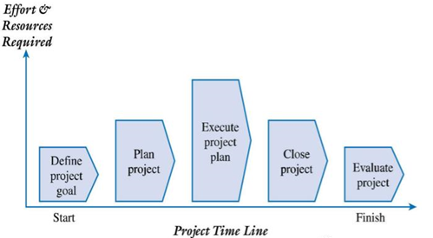
The Project Life Cycle (PLC)
Following Figure provides a generic life cycle that describes the common phases or stages shared by most projects.

Slide 16
PLC : Define Project Goal
Defining the project’s overall goal should be the first step.
This goal should focus on providing business value to the organization.
A well defined goal gives the project team a clear focus and drives the other phases of the project.
The project goal should also answer the question: How will we know if this project is successful given the time, money, and resources invested?

Slide 17
PLC : Plan Project
Once the project’s goal has been defined, developing the project plan is a much easier task.
A plan essentially answers the following questions:
What are we going to do?
What are we not going to do?
Why are we going to do it?
How are we going to do it?
Who is going to be involved?
How long will it take?
How much will it cost?
What can go wrong and what can we do about it?
How will we know if we are successful?

Slide 18
PLC : Plan Project
In addition, the deliverables, tasks, resources, and time to complete each task must be defined for each phase of the project.
The project plan defines the agreed upon scope, schedule, and budget and is used as a tool to gauge the project’s performance throughout the life cycle

Slide 19
PLC : Execute Project Plan
After the project’s goal and plan have been defined, it’s time to put the plan into action.
As work on the project progresses, scope, schedule, budget, and people must be actively managed to ensure that the project achieves its goal.
Progress must be documented and compared to the baseline plan.
In addition, project performance must be communicated to all of the stakeholders.
At the end of this phase, the team implements or delivers a completed product, service, or information system to the organization.

Slide 20
PLC : Close Project
A project should have a definite beginning and end.
The closing phase ensures that all of the work is completed as planned and as agreed to by the team and the sponsor.
Therefore, there should be some kind of formal acknowledgment by the sponsor that they will accept the product delivered.
This closure is often capped with a final project report and presentation to the client that documents that all promised deliverables have been completed as specified.

Slide 21
PLC : Evaluate Project
Sometimes the value of an IT project is not readily known when the product, service, or information system is implemented.
For example, the goal of a project to develop an electronic commerce site should be to make money—not to build or install hardware, software, and Web pages on a particular server platform.
The technology and its subsequent implementation are only a means to an end.
Therefore, the goal of the electronic commerce site may be to produce $250,000 in revenue within six months.
As a result, evaluating whether the project met its goal can be made only after the system has been implemented.

Slide 22
PLC : Evaluate Project
The project can be evaluated in other ways as well.
The project team should document its experiences in terms of lessons learned
things that it would do the same and
things that it would do differently on the next project, based on its current project experiences.
This post mortem should be documented, stored electronically, and shared throughout the organization.
Subsequently, many of these experiences can be translated into best practices and integrated into future projects.

Slide 23
PLC : Evaluate Project
In addition, both the project team and the project itself should be evaluated at the end of the project.
The project manager may evaluate each team member’s performance in order to provide feedback and as part of the organization’s established merit and pay raise processes and procedures.
Often, however, an outside third party, such as a senior manager or partner, may audit the project to determine whether the project was well managed, provided the promised deliverables, followed established processes, and met specific quality standards.
The team and project manager may also be evaluated in terms of whether they acted in a professional and ethical manner.

Slide 24
The Systems Development Life Cycle (SDLC)

Slide 25
Systems Development Life Cycle
Although projects follow a project life cycle, information systems development follows a product life cycle.
The most common product life cycle in IT is the Systems Development Life Cycle (SDLC), which represents the sequential phases or stages an information system follows throughout its useful life.
The SDLC establishes a logical order or sequence in which the system development activities occur and indicates whether to proceed from one system development activity to the next (McConnell 1996).
Planning, analysis, design, implementation, and maintenance and support are the five basic phases in the systems development life cycle.

Slide 26
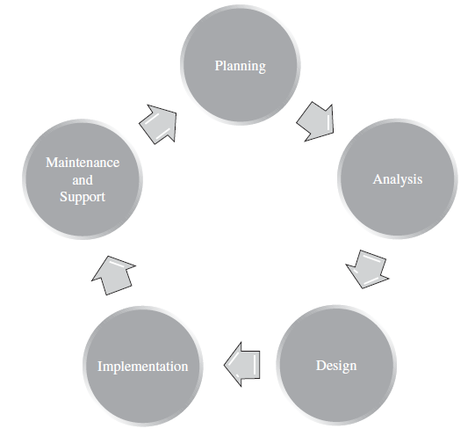
Systems Development Life Cycle
Although there is no generally accepted version of the SDLC, the life cycle depicted in following figure includes the generally accepted activities and phases associated with systems development.

Slide 27
Systems Development Life Cycle
Planning
The planning stage involves identifying and responding to a problem or opportunity and incorporates the project management and system development processes and activities.
Here a formal planning process ensures that the goal, scope, budget, schedule, technology, and system development processes, methods, and tools are in place.
Analysis
The analysis phase attempts to delve into the problem or opportunity more fully.
For example, the project team may document the current system to develop an “as is” model to understand the system currently in place. In general, systems analysts will meet with various stakeholders (users, managers, customers, etc.) to learn more about the problem or opportunity.
This work is done to identify and document any problems or bottlenecks associated with the current system.
Here the specific needs and requirements for the new system are identified and documented.

Slide 28
Systems Development Life Cycle
Design
During the design phase, the project team uses the requirements and “to be” logical models as input for designing the architecture to support the new information system.
This architecture includes designing the network, hardware configuration, databases, user interface, and application programs.
Implementation
Implementation includes the development or construction of the system, testing, and installation.
In addition, training, support, and documentation must be in place.

Slide 29
Systems Development Life Cycle
Maintenance and Support
Although maintenance and support may not be a true phase of the current project, it is still an important consideration.
Once the system has been implemented, it is said to be in production. Changes to the system, in the form of maintenance and enhancements, are often requested to fix any discovered errors (i.e., bugs) within the system, to add any features that were not incorporated into the original design, or to adjust to a changing business environment.
Support, in terms of a call center or help desk, may also be in place to help users on an as-needed basis.

Slide 30
The PLC and The SDLC

Slide 31
The PLC and The SDLC
The project life cycle (PLC) focuses on the phases, processes, tools, knowledge, and skills for managing a project, while the system development life cycle (SDLC) focuses on creating and implementing the project’s product—the information system.
How a project team chooses to implement the SDLC will directly affect how the project is planned in terms of phases, tasks, estimates, and resources assigned.
The SDLC is really part of the PLC because many of the development activities occur during the execution phase of the PLC.
The last two phases of the PLC, close project and evaluate project, occur after the implementation of the information system.

Slide 32
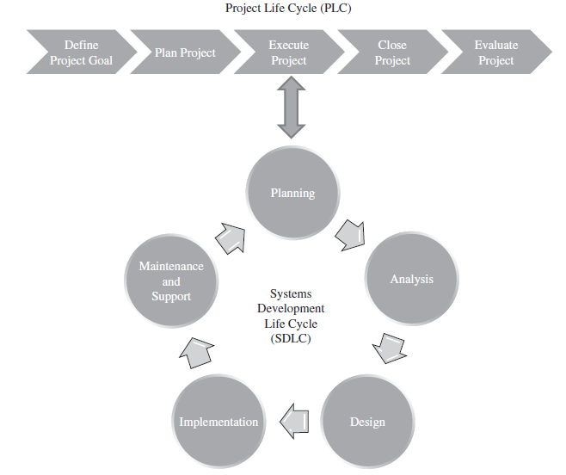
The PLC and The SDLC

Slide 33
End

